Slide 1
Airline Booking System
By:
Purit Thong-On 1106398
Piyapat Russamitinakornkul 1106291

Slide 2
Airline Booking System
Our Task for Our Company

Slide 3
Our task for our company
Provide a new software for an airline booking system and reservation the included features are:
On-line handling of reservations and booking of airline flights.
Authorization of the passengers over the internet.
Handling of the payment (cash, credit cards, etc.).
Database design for Customer Relationship Management.
Human Machine interface (HMI).

Slide 4
Our task for our company (continue)
The task then partitioned into parts that can be easier to understand.
The requirements also have been gathered.
We have to:
Write down one use case, which describe the requirements.
Draw a use case diagram.
Draw a sequence diagram which describe the use case.
Draw a class diagram.

Slide 5
Airline Booking System
Use-Case

Slide 6
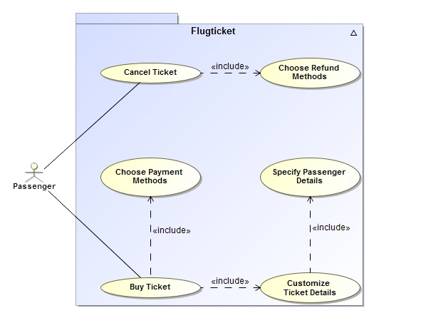
Use-Case Diagram
Passengers can:
Buy Tickets
Specify Travel Details
Fill in Traveller's Details
Select Payment Methods
Cancel Tickets
Pick Refund Methods

Slide 7
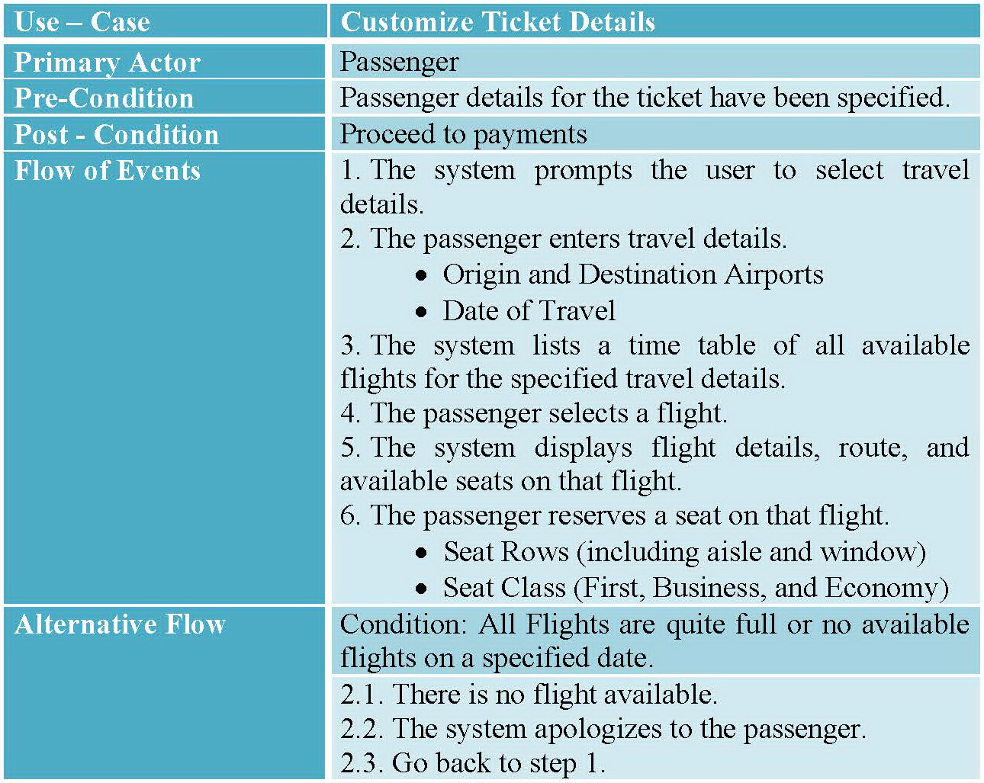
Use-Case Description

Slide 8
AIRLINE BOOKING SYSTEM
Classes

Slide 9
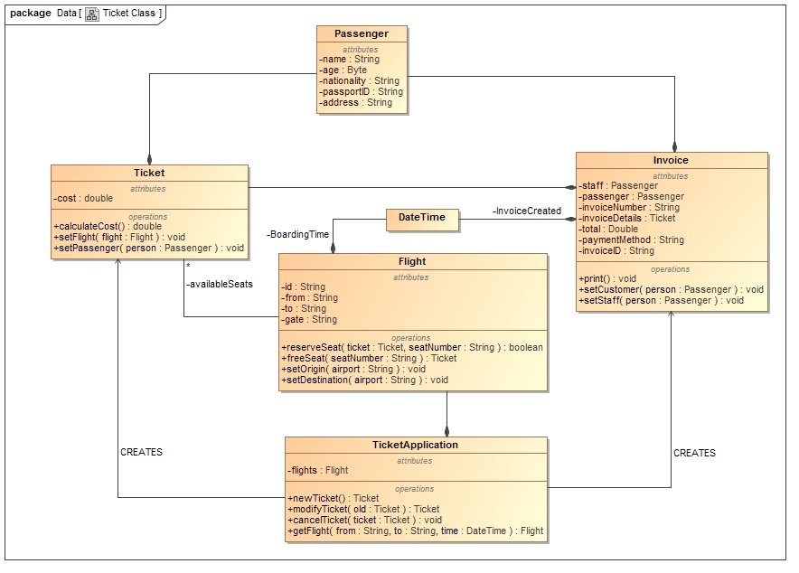
Class Diagram

Slide 10
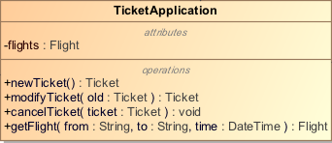
Class Diagram
Main application of the system
Contains all flights

Slide 11
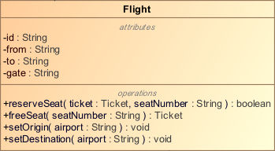
Class Diagram
Contains Flight Details
Contains references to tickets of each reserved seats.

Slide 12
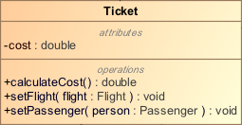
Class Diagram
Contains a cost of itself.
Has a reference to the details of the passenger holding the ticket.
Has a reference to the flight details of this ticket.

Slide 13
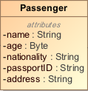
Class Diagram
Contains details of a passenger

Slide 14
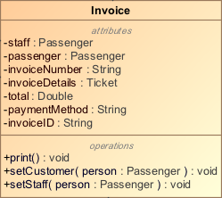
Class Diagram
Contains Billing Details
Generates a layout of information for printing to a hard copy

Slide 15
Class Diagram
Used by:
Flight: Boarding Time Attribute
Invoice: Time the invoice was created

Slide 16
AIRLINE BOOKING SYSTEM
Sequence Diagram

Slide 17
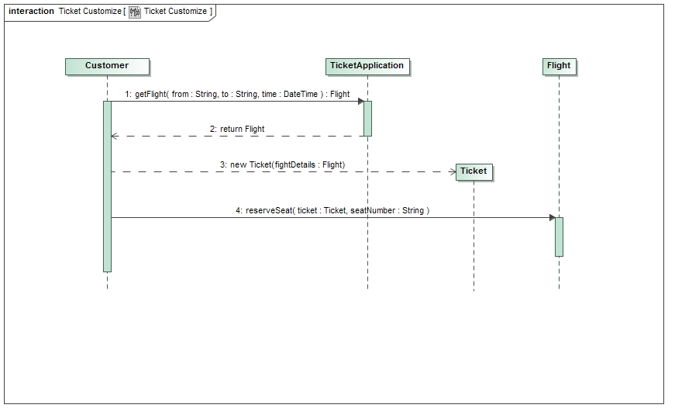
Sequence Diagram

Slide 18
AIRLINE BOOKING SYSTEM
Thank You

